Slide 1
Conserve
Waterwise Landscaping

Slide 2
Purpose of Landscaping
Beauty
Utility
Conservation
Notes:
With water becoming a limited resource, conservation has become a third purpose for landscaping.

Slide 3
Waterwise Options
Zeroscaping
Xeriscaping

Slide 4
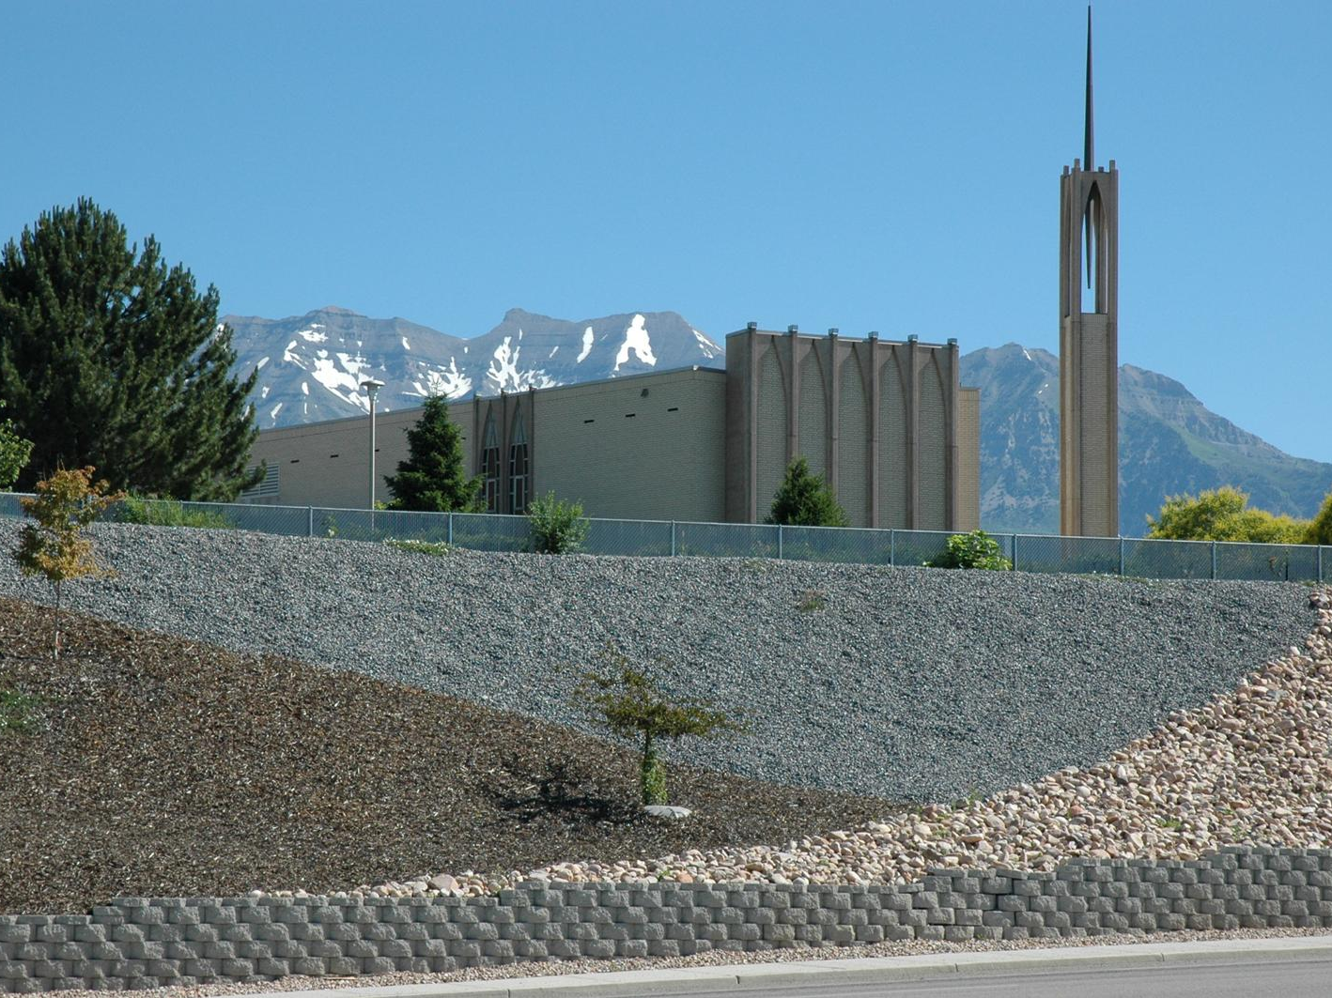
Zeroscaping
Low to No Maintenance Landscaping Design

Slide 5
Characteristics
Uses a variety of rocks for design
Sparse use of drought resistant plants
Relies on rainwater or limited watering

Slide 6
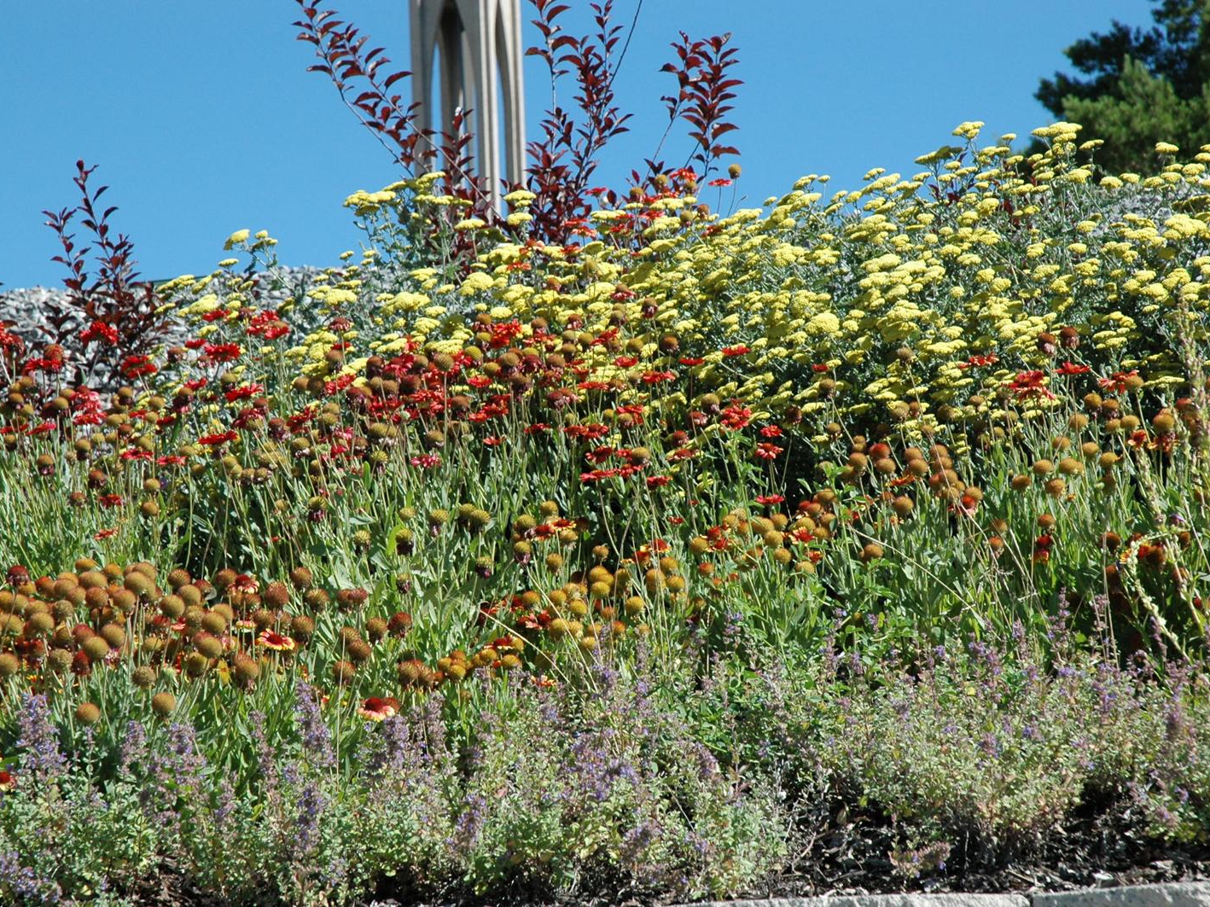
Xeriscaping
Water –Conservative Approach to Landscaping
Notes:
Xeriscaping is created by the combination of the Greek word Xeros (dry) with landscaping. Term coined by the Front Range Xeriscape Task Force of the Denver Water Department in 1981.

Slide 7
Characteristics
Uses a variety of rocks for design
Sparse use of drought resistant plants
Relies on rainwater or limited watering

